Slide 1


Airlines Customer Satisfaction Prediction
A Thesis submitted to
Great Lakes Institute of Management
In partial fulfilment of requirements
for the award of
Post Graduate Programmed in Data Science and
Engineering By
Batch details | PGP-DSE FT MUMBAI January’22
Team members | Kinjal Goswami Sandali Negi Mihir Thanki Rishav Jha
Under the guidance of our mentor: Mr Arpit Sharma

Slide 2
Sr. No. | Contents
1 | TABLE OF CONTENTS
2 | Business Problem statement
3 | Data Description
4 | Project Methodology
5 | Data Pre-Processing
6 | EDA- Exploratory Data Analysis
7 | Statistical Testing
8 | Model Building
9 | Inferences
10 | Model Comparison
11 | Important Features
12 | References

Slide 3
PROBLEM STATEMENT
Airlines industry is currently the biggest industry of transportation in the world. It focuses in service strategy to get costumers, because a great quality of service is a way to get customer loyalty. The objectives of this study are to examine and to identify the ways to increase airline customer satisfaction with service quality dimension, consisting of tangibility, reliability, responsiveness, assurance, and empathy.
Comprised of 25 columns and 130,000 observations, the dataset is an aggregation of customer surveys and encodes a comprehensive set of quantitative and qualitative conditions. Guided by the assumption that customer retention is intrinsically tied to customer satisfaction, our research is designed to maximize positive flight experiences through an analytical lens.
In this project, we hope to create classifiers that can predict if a customer had a positive experience or a neutral or negative one. These models can then be leveraged to identify the factors that contribute most to customer satisfaction; by identifying features most highly correlated with company success, we can distill these variables into actionable insights and applicable recommendations.
Our project analyzes 3 machine-learning models: base model , decision trees and tuned Decision Tree Model. In balancing their computational efficiency against their performance metrics, we can provide a comprehensive audit of the ideal market model.
PROJECT OUTCOME
Our aim is driven by our guiding question: can we identify the most economically-friendly factors that airlines can invest in to improve customer satisfaction?

Slide 4

DATA SET
● A dataset is a collection of data, and it can be structured or unstructured.
● A structured data is represented in a tabular format, where every column of the table represents a particular variable, and each row corresponds to a given record of the dataset.
● Unsupervised/unstructured data is not represented in a tabular form, data that we fetch from Kaggle.

Slide 5
Data Description
This Dataset Comprised of 25 columns and 130,000 observations, the dataset is an aggregation of customer surveys and encodes a comprehensive set of quantitative and qualitative conditions.
Gender: Gender of the passengers (Female, Male)
Customer Type: The customer type (Loyal customer, disloyal customer)
Age: The actual age of the passengers
Type of Travel: Purpose of the flight of the passengers (Personal Travel, Business Travel)
Class: Travel class in the plane of the passengers (Business, Eco, Eco Plus)
Flight distance: The flight distance of this journey
Inflight wifi service: Satisfaction level of the inflight wifi service (0:Not Applicable;1-5)
Departure/Arrival time convenient: Satisfaction level of Departure/Arrival time convenient
Ease of Online booking: Satisfaction level of online booking
Gate location: Satisfaction level of Gate location
Food and drink: Satisfaction level of Food and drink

Slide 6
Online boarding: Satisfaction level of online boarding
Seat comfort: Satisfaction level of Seat comfort
Inflight entertainment: Satisfaction level of inflight entertainment
On-board service: Satisfaction level of On-board service
Leg room service: Satisfaction level of Leg room service
Baggage handling: Satisfaction level of baggage handling
Check-in service: Satisfaction level of Check-in service
Inflight service: Satisfaction level of inflight service
Cleanliness: Satisfaction level of Cleanliness
Departure Delay in Minutes: Minutes delayed when departure
Arrival Delay in Minutes: Minutes delayed when Arrival
Satisfaction: Airline satisfaction level(Satisfaction, neutral or dissatisfaction)

Slide 7
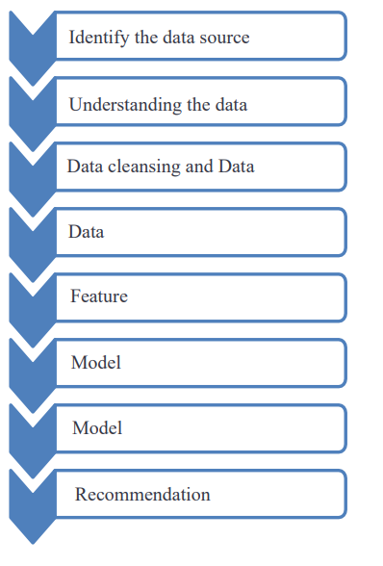
Project Methodology
DATA PRE-PROCESSING
Data Preparation:
Data pre-processing is a crucial step that helps enhance the quality of data to promote the extraction of meaningful insights from the data. Data pre-processing in Machine Learning refers to the technique of preparing (cleaning and organising) the raw data to make it suitable for building and training Machine Learning models.
Data Preparation is the process of collecting, cleaning, and consolidating data into one file or data table, primarily for use in the analysis.
Acquire the data set: https://www.kaggle.com/datasets/teejmahal20/airline-passenger-satisfaction

Slide 8
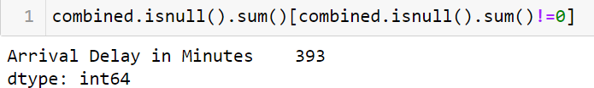
Missing/Null Values:
As we can see that only one column i.e. Arrival Delay has null values in it .
We will deal with the null values in the further process by either imputing values or dropping the column.
DROP COLUMNS
As we can see that the Unnamed:0 and id column contain all unique values which do not give us any relevant information about the customer satisfaction .
Thus we can drop these columns from the dataset.

Slide 9
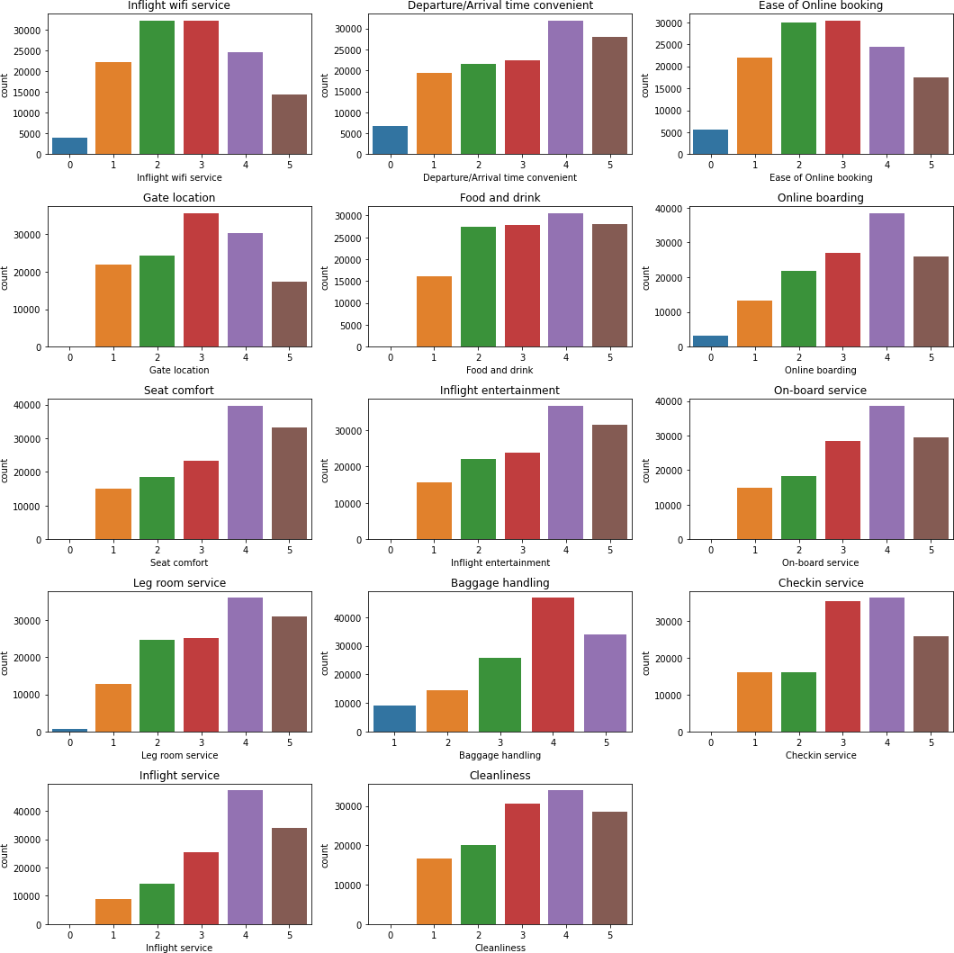
EXPLORATORY DATA ANALYSIS & BUSINESS INSIGHTS
Univariate Analysis:

Slide 10
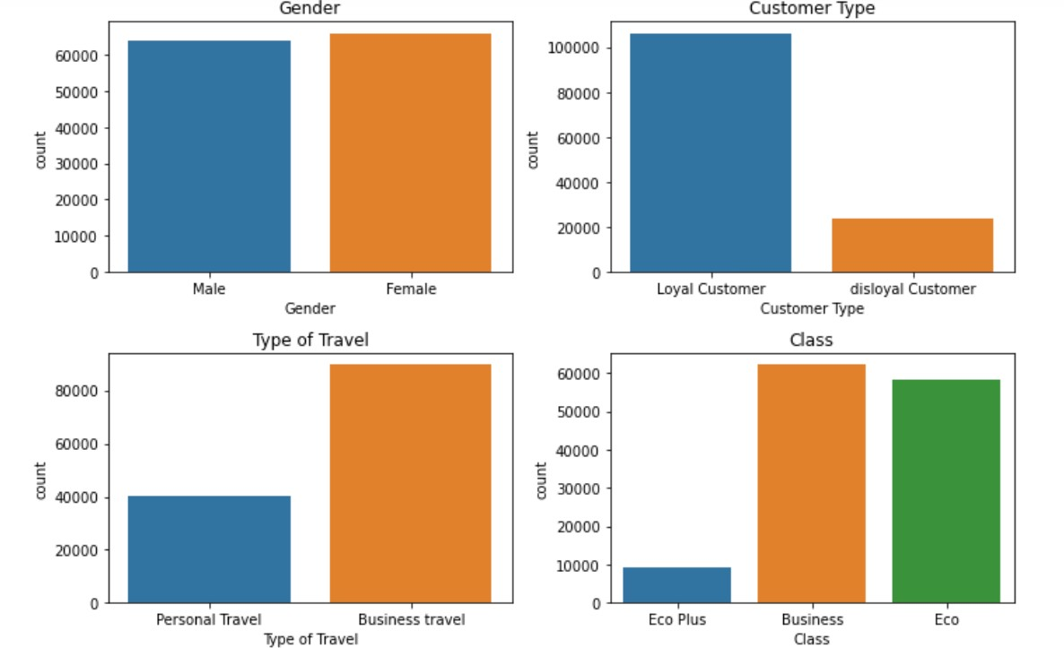
The above graphs are the count plots for each independent categorical variable that essentially represents the satisfaction level of customers in respect to the different services provided by the airline.
The above graphs shows the countplot of the categorical variables i.e. Type of travel , Class, Gender, Customer Type. It shows that many passengers prefer business class over others and the main purpose of travel for most passenger is business related.

Slide 11
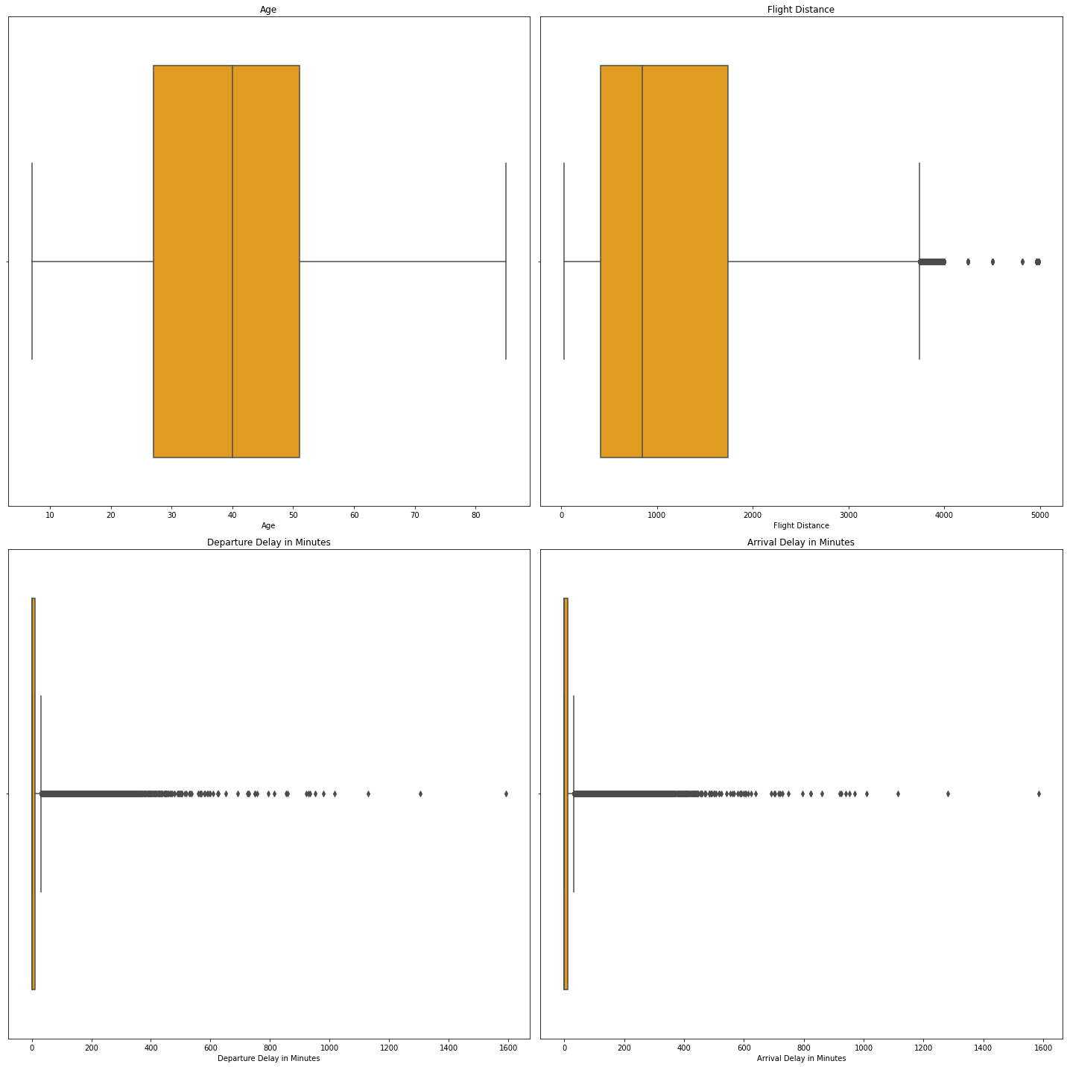
The above graphs shows the spread of the numerical variables i.e. Departure delay , Arrival delay, Flight Distance and Age of the customer .It shows the presence of outliers in the numerical variables .

Slide 12
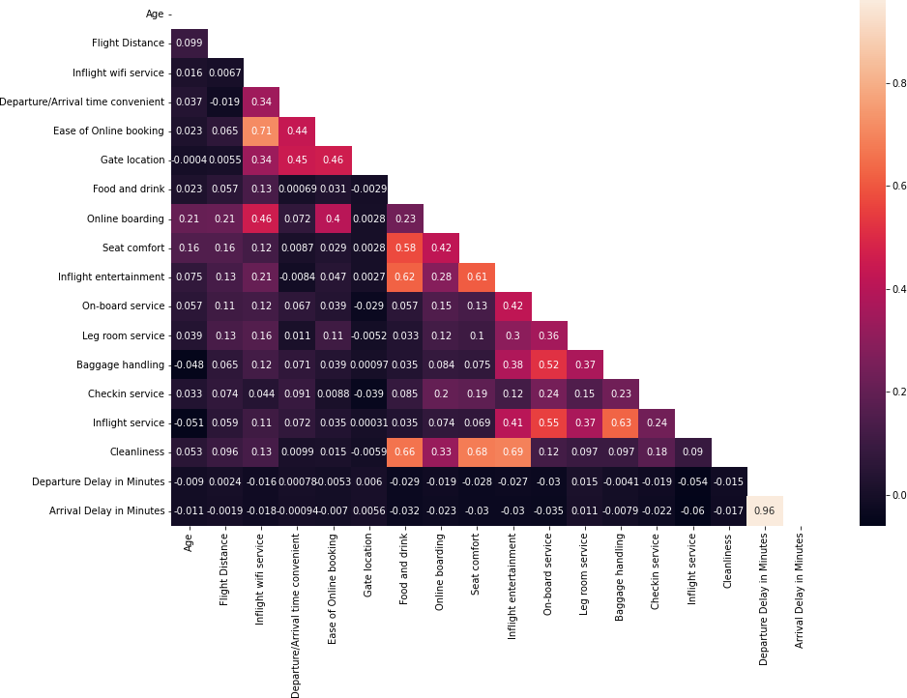
Bi-variate analysis:

Slide 13
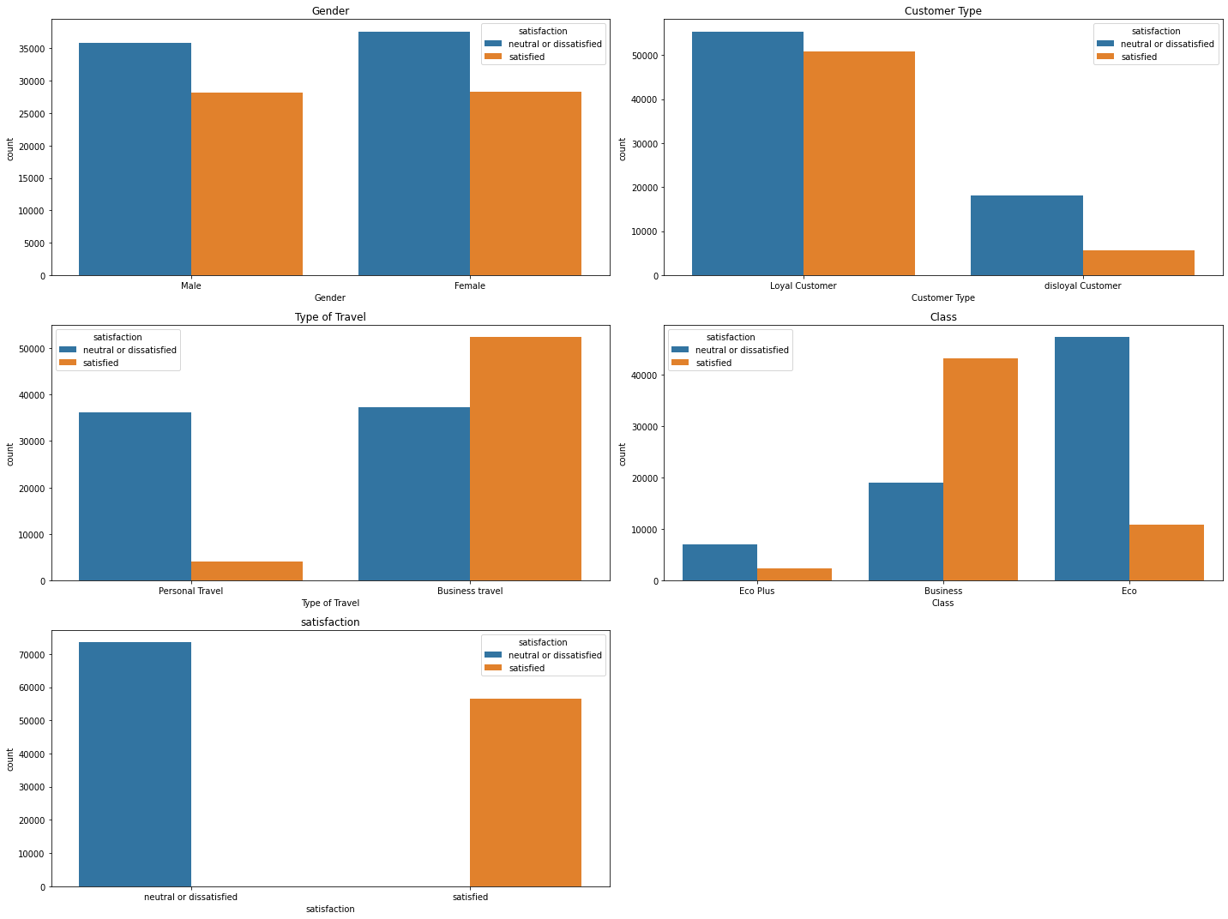
The graph above is the bivariate analysis of independent variables. Here, it can be inferred that there is a high correlation between many independent numerical variables which can lead to multicollinearity in the data.
The graphs show the bivariate analysis of independent categorical columns with the target variable. It can be inferred that in most sub categories of the categorical variables, the distribution of satisfied and dissatisfied customers are not the same.

Slide 14
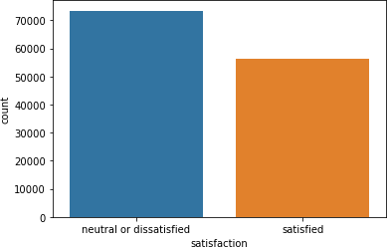
The above is the bivariate analysis of independent categorical columns with the target variable. It can be inferred that in most sub categories of the categorical variables, the distribution of satisfied and dissatisfied customers are not the same.
Univariate analysis of target feature:
We can also infer that the target class is balanced with 56% of passengers belonging to the neutral
/dissatisfied class and 43% from the satisfied class.

Slide 15

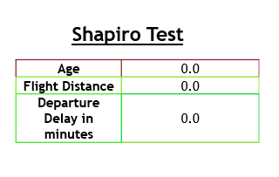
Statistical Analysis
Checking the distribution of the features using Shapiro Wilk Test at 5% of level of significance
● The hypothesis test of the independence of attributes
Ho: The attributes follow normal distribution
Ha: The attributes doesn’t follow normal distribution
The p-value of the features are less than 5% percent that is 0.05,which means result is significant and will reject the null hypothesis
The features doesn’t follow normal distribution

Slide 16
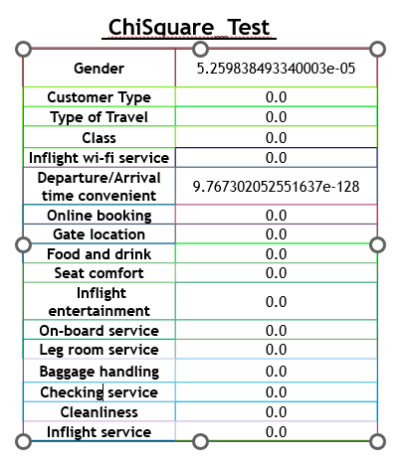
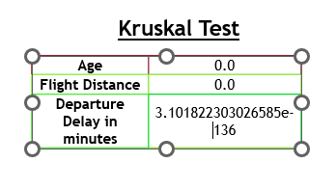
Non-parametric test
As the features are not following normal distribution , we will go for Non-parametric test
For Numerical features we will use Kruskal test for checking the significant features
For categorical test we ill use Chisquare test for checking the significant features
For both test the null hypothesis is that the feature is important and Alternative is that the feature is not important
Since the p-value for all the features are less then 0.05,which indicates that all the feature are important

Slide 17
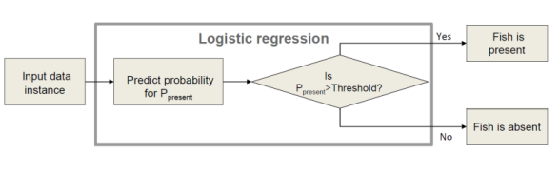
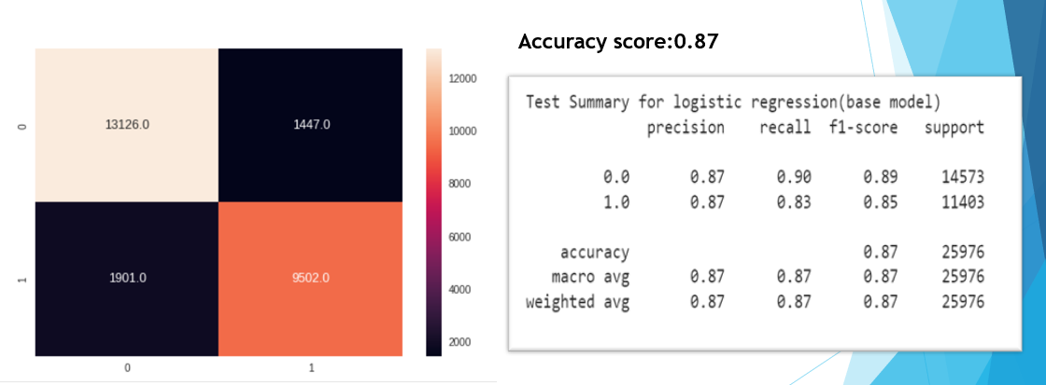
Model Building:
Logistic regression:
● Logistic Regression is a binary classification algorithm. It predicts the probability of occurrence of a label class.
● Consider that logistic regression is used to identify whether the product falls under the advantage category or not

Slide 18
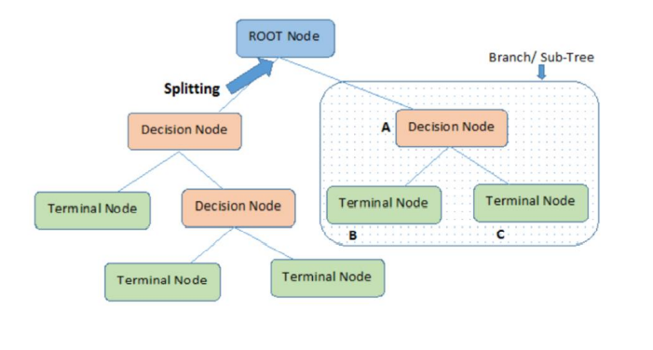
Decision Tree
• Decision trees can be used for classification as well as regression problems.
• The name itself suggests that it uses a flowchart like a tree structure to show the predictions that result from a series of feature-based splits.
• It starts with a root node and ends with a decision made by leave

Slide 19
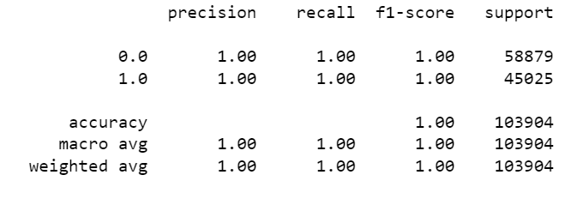
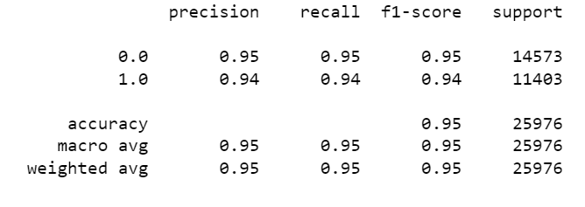
Classification Report:
Train
Test
As model is doing good in Train data set but not in test data set.
Thus , leading to overfitting

Slide 20
HYPER-PARAMETERS:
Pre-pruning can be done by specifying the following hyperparameters:
criterion:
• The criterion available here are Gini and entropy
• It determines the basis of a split. max_depth:
• It is the maximum length of the decision allowed to grow.
• Once the max_depth value is reached the tree will not grow further.
min_samples_split:
• The minimum samples are required to split an internal node.
max_leaf_nodes:
• It helps create the tree with “max_leaf_nodes” in best-first fashion.
• Once the max_leaf_nodes value is reached the leaf nodes will not grow further n-estimators:
• This is the number of trees you want to build before taking the maximum voting or averages of predictions.
HYPER-PARAMETER TUNING:
• Hyper tuning the parameters is needed to reduce the overfitting of the model and also to further refine the model. • The hyperparameters can be tuned using the Grid Search method. It considers all the combinations of the hyperparameters and returns the optimal hyperparameter values.
• The tuned parameters resulted from the Grid search method as follows for Decision Tree and Random Forest are as follows:
o Criterion: Gini ,Max_depth: 10 ,Min_sample_split: 2 , max_leaf_nodes: 15

Slide 21
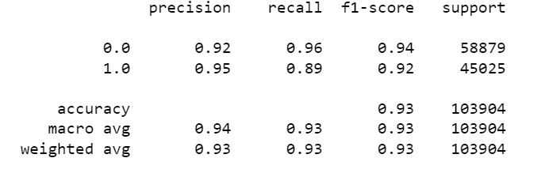
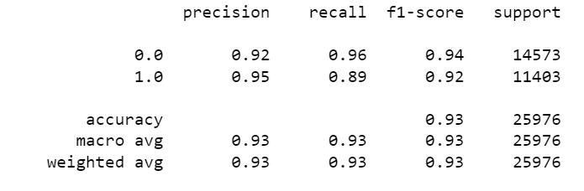
Tunned Decision Tree
Classification Report:
Train
Test
After tunning the parameter of Decision tree model, we are getting satisfied result

Slide 22
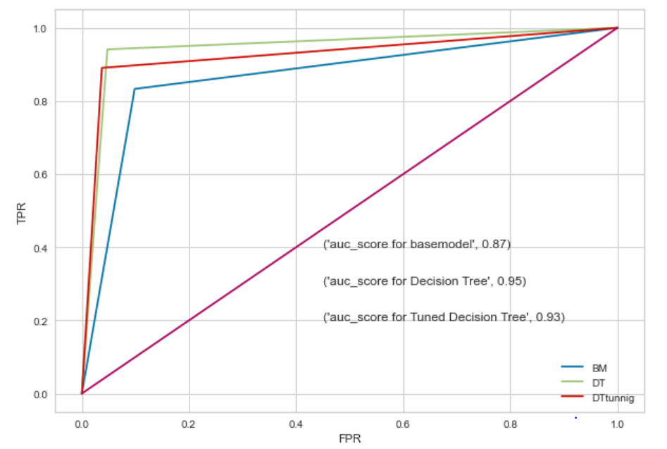
Model Comparison : Area Under the curve
The above graph shows the area under the curve
Both the decision tree without tunning and with tunning parameter shows high accuracy score
Since without tunning parameter decision tree model is overfitted, we consider decision tree model with tunning parameter as the best model

Slide 23
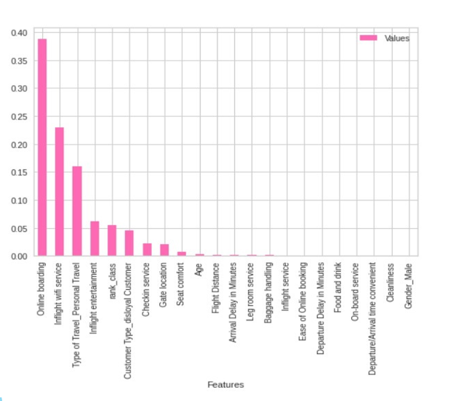
Important Features
Online boarding , Inflight wifi service , Type of travel and inflight entertainment plays the important role in predicting that the traveler is satisfied or not

Slide 24
Conclusion and Insights
As you can see online boarding, inflight wi-fi service, and airline classes represented the 3 most important factors for the satisfaction predictions. A simple explanation is that these factors form a part of prediction power of the Decision Tree Model
If these factors were dropped from the model, it’s prediction power would greatly reduce. As shown from the Base Model, these 3 factors remain the most important and contribute the best predictions of customer satisfaction
Airlines should focus on its cleanliness as it is highly correlated with other services leading to customer satisfaction and dissatisfaction
Airlines should also focus on Ease of Online Booking, as business passengers prioritize on ease and convenience in their travel.
Airlines should focus on improving the Inflight Wi-Fi Service experience. For instance, airlines could develop better software to allow easier access to inflight wi-fi.

Slide 25
References:
https://www.kaggle.com/datasets/teejmahal20/airline-passenger-satisfaction
https://towardsdatascience.com/predicting-satisfaction-of-airline-passengers-with-classification-76f1516e1d16

